Slide 1
Serial Protocol Analyser
Design of serial protocol analyser to capture and analyse data packets on RS-485 bus.
Uses an STM32 F4 micro controller running at 84MHz to capture data on the bus and a PC application to analyse the data.

Slide 2
System block diagram

Slide 3
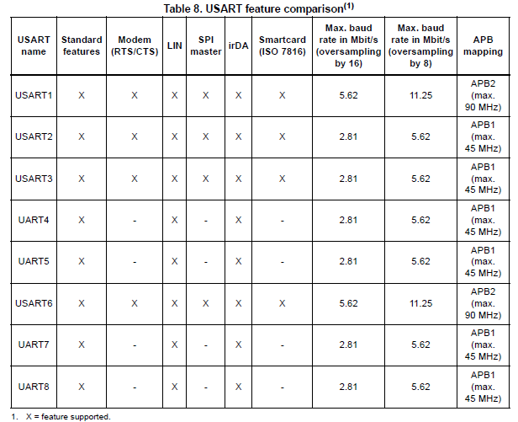
USART on STM32 microcontroller

Slide 4
USART on STM32 microcontroller
Oversampling to give flexibility between speed and tolerance.
Multi buffer communication using DMA
Buffer of received/transmitted bytes in reserved SRAM using centralized DMA
Separate enable bits for transmitter and receiver
Multiprocessor communication – enter into mute mode if address match does not occur.
Error handling and hardware flow control as standard.

Slide 5
USART on STM32 microcontroller

Slide 6
Data packet format
All data packets start with 55h and are delimited via length field at start of the packet.

Slide 7
Interface between PC and inline sniffer
The inline sniffer board is connected to the PC via an USB interface, acts as an USB device.
Full speed USB 2.0 achieving up to 12Mbits/s.
The PC application controls the inline sniffer operation by sending start and stop commands.
The captured data on the inline sniffer board is transferred to the PC via an USB interface.

Slide 8
Data transfer between PC and inline sniffer
The data packets from the RS-485 bus start with 55h and are delimited via length field at start of the packet.
The same data packet format is used between inline sniffer and the PC, but with addition USB headers. This helps reducing processing time on the inline sniffer.

Slide 9
PC Application
The PC application analyses the incoming data and displays it to the user.
The PC application also stores the incoming data to the disk for future references.

